Slide 1

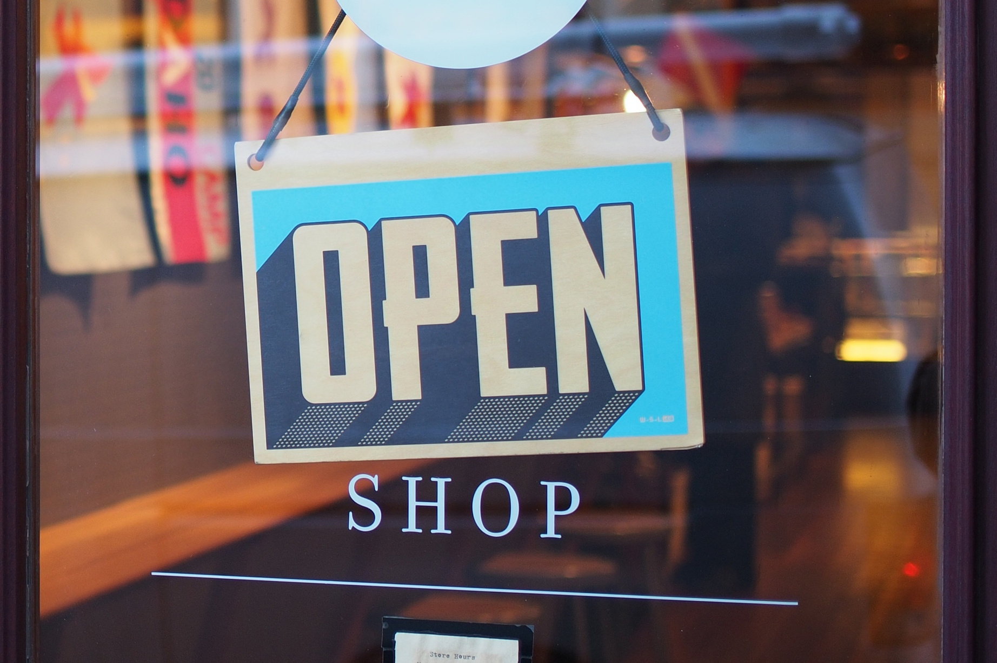
S
SIMULATION MODELLING PROJECT
STORE
QUEUE
OPTIMIZATION
01
Purav Tekwani
Dhruv Khanna
Daksh Khandelwal
Dhruvi Shah
Pratiksha Sharma
Rithwik Chhugani
Swraj Palekar
Duc Long Ngo

Slide 2
STORE QUEUE OPTIMIZATION
02
Table of Contents
Background
Introduction
Problem Statement
Methodology
Results
Conclusion
Presentation Outline

Slide 3
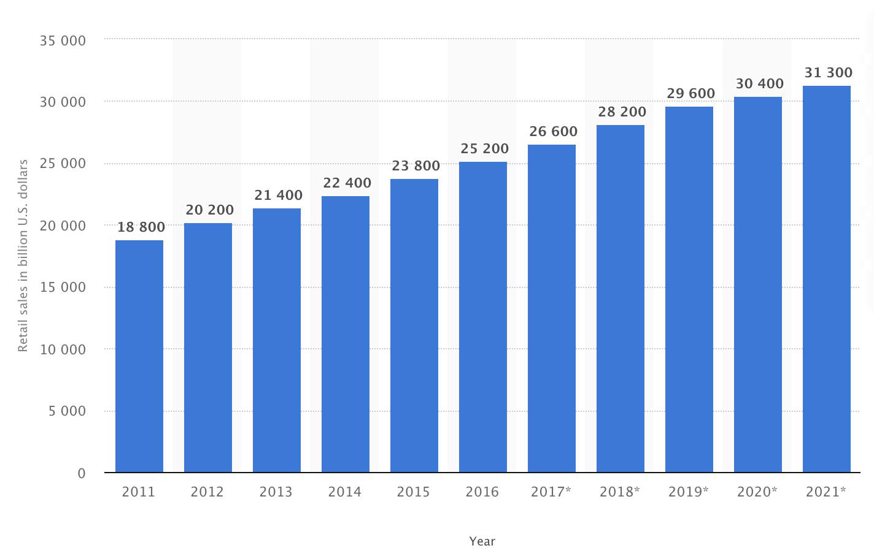
BACKGROUND
Nowadays, supermarkets are the main way people get groceries. With a total retail sales of 18800 B (USD) in 2011 and is predicted to reach 31300 in the year of 2021. On average, a person would spend 50-100 AUD/ week on groceries in Australia. But nowadays, with the development of smart phone, people have become less and less patent.
5

Slide 4
INTRODUCTION
Nowadays, people generally get groceries from stores and supermarket. While stores only have a limited type of item, supermarket are normally big and have a wider selection of items. But browsing, searching and checking out in the supermarket is time-consuming, especially in rush hour. Many times, we have witnessed few active counters in the store during peak hours leading to hour long queues and fights due to the reducing tolerance level of individuals. Hence, it will reduce customer satisfaction.
One way to solve this is to add more counter to speed up check-out process. But with the fluctuation of number of customer at a particular time in a particular day, it is difficult to find the number of counter which keep the customer satisfaction above some threshold while remaining supermarkets’ profit. To solve this problem, we thought to run simulations in controlled setting to understand the number of active queues the stores require during peak hours to avoid massive delays and low customer satisfaction while maximize the profit.
5

Slide 5
PROBLEM STATEMENT
Our simulation problem is based on optimizing the satisfaction and wait-times of a consumer while minimizing the number of active cash-counters which in turn reduces the operational cost incurred by the store.
1. Function or objective to be optimized: Multi-Channel Queue Optimization
2. Parameters or variables to be used:
Customer Population – Arrival Time, Tolerance, Cart Size, Picking Rate, Status etcetera.
Checkout/Queue Operator – Efficiency / Packing Time.
Customer Satisfaction – Calculated using a custom equation using the existing variables.
5

Slide 6

METHODOLOGY
The idea of a time loop is a simple iteration through each second of the store opening times.
Within the time loop as it iterates further, we observe all the processes mentioned above.
New customers walk in, they start buying a set of items While buying the items the tolerance of the customers also keeps decreasing (Basically the customers get tired as they spend time buying the items)
As soon as they’re done with shopping, they are channeled to the queue where the billing takes place
Therein lies our queue optimization algorithm. The queue channel does 2 kinds of processes:
Popping customers out of the queue
Pushing customers into the queue
5
TIME
LOOP

Slide 7
METHODOLOGY:
OPTIMISATION ALGORITHM
5
For the algorithm, we are using the following metrics:
1. Wait time = (summation of number of cart items * packing rate) + (number of people in the queue * 5)
2. Customer Satisfaction = 100 – (wait time * wait time constant + tolerant constant*(100-customer tolerance))
3. Exit time = time the customer joined the queue + wait time + (cart size * packing rate) + 5

Slide 8
METHODOLOGY:
OPTIMISATION ALGORITHM
5
Popping a customer from a queue
We first carry out the popping step by removing any customers that might have completed their billing. In case the counter becomes free or only one person is in the queue, the parameters are reset to its initial values. This facilitates straight addition for a second person in the queue.

Slide 9
METHODOLOGY:
OPTIMISATION ALGORITHM
5
Pushing a customer into a queue
Pushing a customer depends on evaluating the wait time and satisfaction metrics of the queue. If these values are above a certain threshold, a new customer is added to the queue. If the satisfaction level does not satisfy the threshold level, we skip the queue and search for a counter which matches the satisfaction level. This also leads to re-calculation of the queue metrics and thus, the cycle goes on.

Slide 10
METHODOLOGY
6
Coming back to the main Time Loop.
This way the queue proceeds with time and orders are processed While customers stand in the queue their wait time is noted and as this weight increases, the customer satisfaction gets penalized.
This penalization is and final customer satisfaction levels after they’re done with shopping is the problem that we’ll be solving in the project
TIME
LOOP

Slide 11
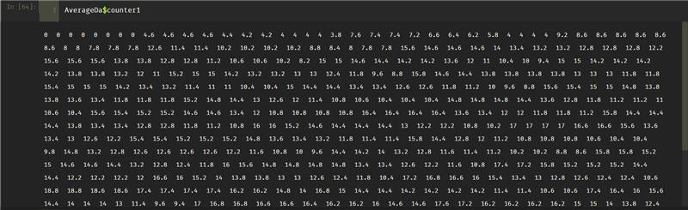
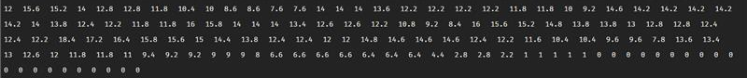
RESULTS
The first few minutes of the store rarely ever have any customers at counter 1, this is due to the early opening hours. Gradually the number of customers increase at the counter. The maximum number of people at this particular counter through the day are 18. We can also see that towards the end of the day the number of people at the counter begin decrease again. The middle of the day sees the most number of people
5

Slide 12
RESULTS
We can see times when the counter has no one joining the queue or if the number of people is too low then the store can decide to shut the counter at those times of the day.
As this is an average over a few days we can get an estimate of the queue density at various times of the day
5

Slide 13
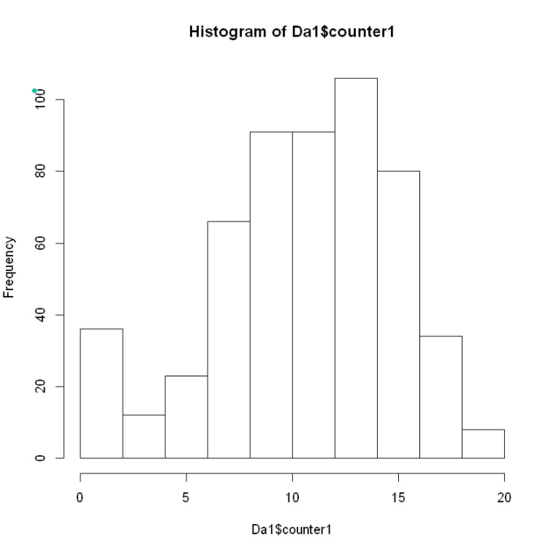
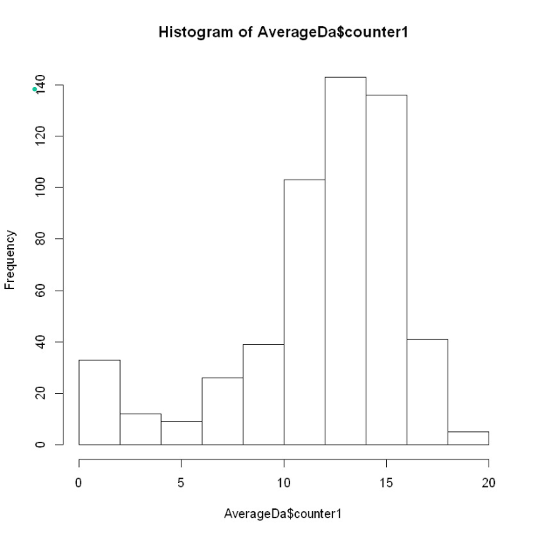
RESULTS
5

Slide 14
CONCLUSION
5
Using the store simulator ,we can run the store hours for various days and with various distributions and store size by tuning the parameter of the simulation.
After simulating the shopping and billing processes for several days we can try finding patterns in the mean number of people at a particular counter at various times of the day and then decide based on the operation costs and density of the queue to then control the number of operatable counters.
This way we can save cost for the store and maintain the customer satisfaction levels of the store as well.

Slide 15
THANK YOU!

